Slide 1
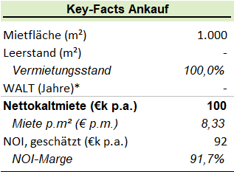
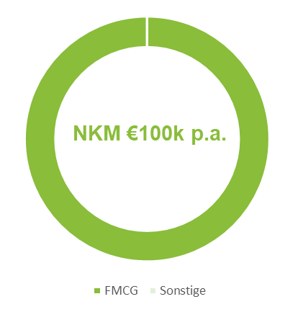
ID: 1, Beverstedt, Logestraße 42-44
Description
Location and Environment
Oldenburg is located in the northwest of the Federal State of Lower Saxony, approximately 50 km west of Bremen and 85 km east of the Dutch border. As a regional metropolis, the city is an important retail location for the Region Weser-Ems. Purchasing power (101.3) is above average of German cities.
The town is connected to the highways A28 and A29 as well as to the federal road B401. Oldenburg’s train station is well connected to other cities through intercity (IC), intercity Express (ICE) and regional train lines.
The hypermarket with 700 parking slots was constructed in 1974 and it is located north of the city. The surroundings are characterized by a conglomerate of retail properties.
Due to the location next to the on ramp of the B293 Federal road, the visibility is good. Besides, a bus station with four different bus lines ensures good accessibility via public transport.
Economic KPIs
Tenancy Schedule
FMCG Share
(1) Calculated as of 01/01/2022

